Slide 1
“BUILDING UNIT”
PROCESS OF BUILDING PLAN SUBMISSION

Slide 2
◆ LEGISLATIVE MANDATE OF BUILDING UNIT
Is to educate the community on building plan submission
processes relating to:
Legislative mandate of(NBRS ACT): (NATIONAL BUILDING REGULATION STANDARD - ACT 103 of 1977)
Why should property owners need to submit plans to the Local
council.
Why is it necessary to obtain Town Planning authority prior to making a building application?
Spluma ( Alignment with Spatial Development Framework, Local Areas plans and site development plans)
Who can draw plans ?
What need approval ?
Before submit a plan (what needs to be done)

Slide 3
What do I need to submit with a building plan?
What happened after submitting a plan?
How long does it take to process my building application authorization prior to making a building authorization?
How many copies of building plan needs to be submitted?
Decision (2 decisions approve or refuse)
How long will it takes for a plan to lapse.
Office hours.
Building plan processes.(Diagram)

Slide 4
1. LEGISLATIVE MANDATE: (NATIONAL BUILDING REGULATION STANDARD - ACT 103 of 1977)
Is to provide a uniformity in the law relating to:
The erection of buildings in the areas of jurisdiction of Local
Authorities.
For the prescribing of building standards and; for
The matters connected there with.
SECTION 4 “ No person shall without the prior in writing of the Local Authority in question, erect any building in respectof which plans and specifications are to be drawn and submitted in terms of this act”.

Slide 5
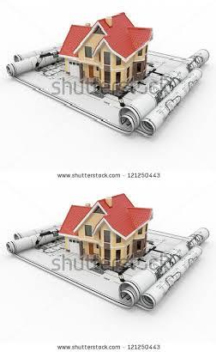
2. Why property owners must to submit plans to the Municipality .
The requirement to obtain approval before building is not just a local Municipality requirement
Required in terms of the National Building Regulations and Building Standard Act and applies throughout the country
Ensures a safe and healthy living environment for you and your family
Is a prerequisite to obtaining a bond.
It is a legal requirement which means that building without approval may result in prosecution and financial hardship.

Slide 6
3. WHY IS IT NECESSARY TO OBTAIN TOWN PLANNING AUTHORITY PRIOR TO MAKING A
BUILDING APPLICATION?
◆ In order to access and approve a building application:
it is necessary to ensure that ALL Planning related controls application to a site have been satisfied and that there is no impediment that hampers the use to effected on the site.
Zoning
Development controls and land use rights
Building lines, side and rear spaces/ encroachments
Building foot print and services
Ownership

Slide 7
4. SPLUMA
Alignment of Development with the following
Spatial Development Framework
Local Area Plans and Schemes (Nodal Areas)
Site development plans (Services, Land Use)

Slide 8

5.Who can draw the plans?.
◆ The law requires that only persons
registered with the South African Council for the Architectural Profession (SACAP) may
draw and submit building plans.
◆ Ensure that the person drawing your plans is suitably registered
Failure to that the plan will not be considered

Slide 9
6. What need approval
Any building to be erected on your property requires a plan be submitted for approval.
This include new building, alteration or additions to buildings, boundary walls, swimming pools, garages, Wendy houses and tools sheds to mention few.
Plans are also required where the use of a property is to be changed (rezoning). For example, if you want to run a crèche or business from your house.

Slide 10
7. Before submitting a plan (what needs to be done)
Firstly verify the Town Planning requirement through Town Planning Department
This is done at the same office where you will submit your building application.
Your appointed architectural professionals or our staff, who can be reached on the telephone numbers provided, can advise further if necessary.

Slide 11
8. What accompanies the building plan?
◆ A copy of your Title Deed or Lease Agreement as well as generally 4 copies of the plan on which the new work is to be clearly shown together with the application form which you can get from our offices.
◆ On submission; a fee according to the “Tariff of Charges” will be calculated and which must be paid before your plans can be considered.
◆ NB: only registered architectural professionals can draw and submit your plans. They will be familiar with submission process and can advise accordingly.

Slide 12
9. What happened after submitting a plan?
Your plan(s) will be circulated to different municipal departments (Town Planning, fire & technical service) after which a decision will be made to approve or refuse your application.
If your plan is refused you will be told why in writing and given an opportunity to correct the plan so that it can be resubmitted. If the plan(s) is corrected and resubmitted within 1 year from the date on which it was refused, the owner will pay 25% of what he/she paid in a previous approval plan.

Slide 13
10. How long will it take to process my
building application authorization prior
to making a building authorization?
◆ The local authority will endeavour to provide you with a response within 30 days of your application being submitted.
◆ When your application is approved, you will be contacted to collect a copy of the plan, which will have on it an approval stamp, and a letter containing important information.

Slide 14
Only when approval has been granted may you begin to build. Remember to call the Building Inspector when necessary in order to inspect progress.
This is necessary so that on completion of the building, the Building Inspector may issue a certificate of occupancy which will confirm that the building has been built in accordance with the approved plans and allow you to use / occupy the building.
NB: If the building is less than 500sqm = 30 days
more than 500sqm = 60 days

Slide 15
11. How many copies of building plans need to be submitted?
◆ 4 sets ( 2 coloured and 2 black/white)
◆ 6 sets (recommended)
◆ The additional copies recommended will assist in the circulation to outside departments for comments or where fire plans are required

Slide 16
12. How long will it take for a plan to lapse.
◆ National Building Regulations and Building Standards Act no. 103 of 1977 (NBRS) clearly states that in any application shall lapse after expiry of the period of 12 months of the date which was granted, unless the erection of the building in question is commenced within the said period or unless such local authority extended the said period at the request in writing of applicant. NBRS SECTION 7 (4)

Slide 17


13. Decision
Only one of two options.
Approve or Refuse
proceed with your construction
to resubmit and repay building
submission fees in full amount

Slide 18
15. OFFICE HOURS
◆ Building Applications may be submitted to the Jozini Municipality Offices: PLANNING AMD ECONOMIC DEVELOPMENT SERVICES
between the following hours
Monday to Thursday
Lunch
Friday
Enquiries
: 8:30 -
: 12:30 -
: 8:30 -
16:00
13-00
14-00
Telephone No .: 035 572 1292
Email address : tndaba@jozini.gov.za
: lndlovu@jozini.gov.za

Slide 19
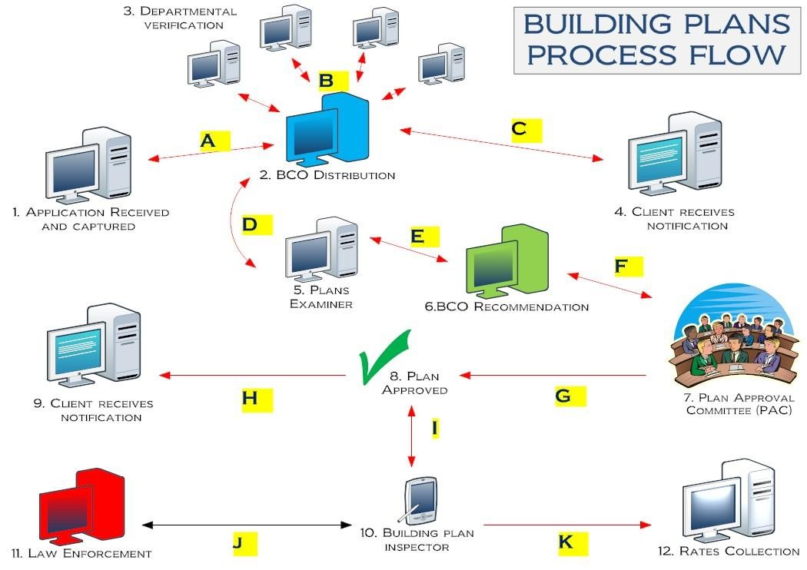

Slide 20
Thank you.
Ngiyabonga.

